Slide 1
Problems with open set Vision and Language problems
Anton van den Hengel,
The Australian Institute for Machine Learning, Director
The University of Adelaide, Professor

Slide 2
The people
Peter Anderson
Now Georgia Tech, was ACRV
Damien Teney
AIML, ACRV
Qi Wu
AIML, ACRV
Stephen Gould
ANU, ACRV
…

Slide 3
Bring me a spoon
Robots aren’t really very good at very much
Why do I still have to unpack the dishwasher?
Is it a robot vacuum cleaner if I still have to empty it myself?
Why can’t my robot lawn mower cut the hedge?
Or even just leave the lawn long around the tree
A five year old can bring me a spoon

Slide 4
Open sets
I want to be able to ask my robot
Where did I leave my keys
Did I leave the headlights on
Answer the front door, but if the people there have name tags on tell them to go away
Plant this pot plant in the back yard next to the other azaleas
Unpack the dishwasher, but this time stack the black plates and the white ones separately
Find my old Milli Vanilli records and burn them
I want to be able to have a flexible conversation with my robot, and get a sensible result
This is a fundamentally open set problem

Slide 5
Open sets
The real world has combinatorial complexity
It’s not possible to enumerate all of the situations of interest
We can’t even imagine them, let alone train on them
So the problem won’t be solved by just gathering more training instances
We need to change the question, not the data
We need to test generalisation
We will, of course, still need better data
It’s just not the answer alone

Slide 6
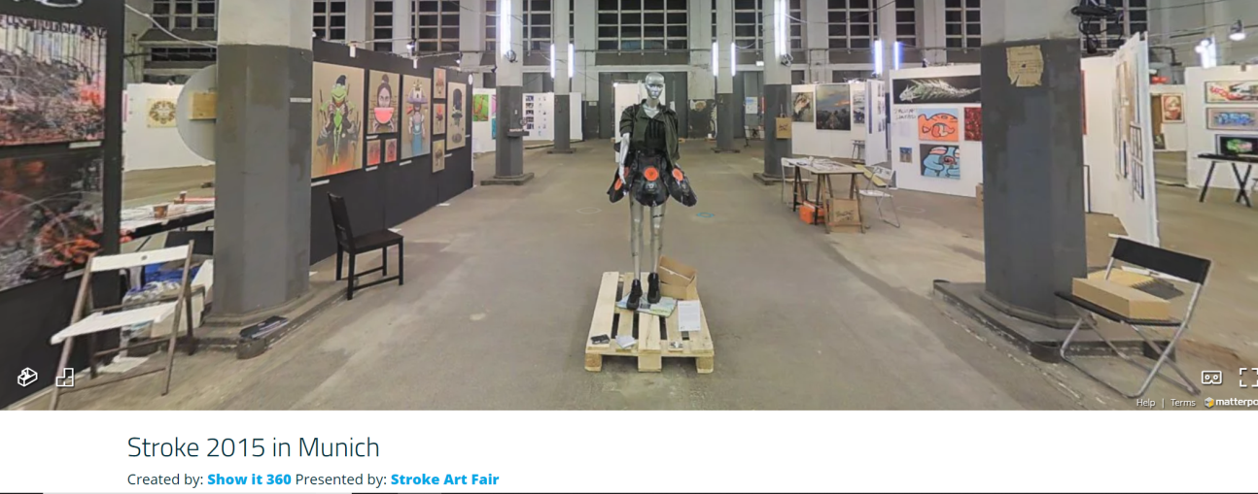
Vision and Language Navigation dataset
Real natural language instructions
By Turkers, so there’s still no real objective beyond navigation
Different object definitions, and different names for the same object
Real images
There’s a fixed number of them, so it’s not truly open set, but it’s close
So ‘Dataset’ still means closed set
But we’re as open set as possible

Slide 7
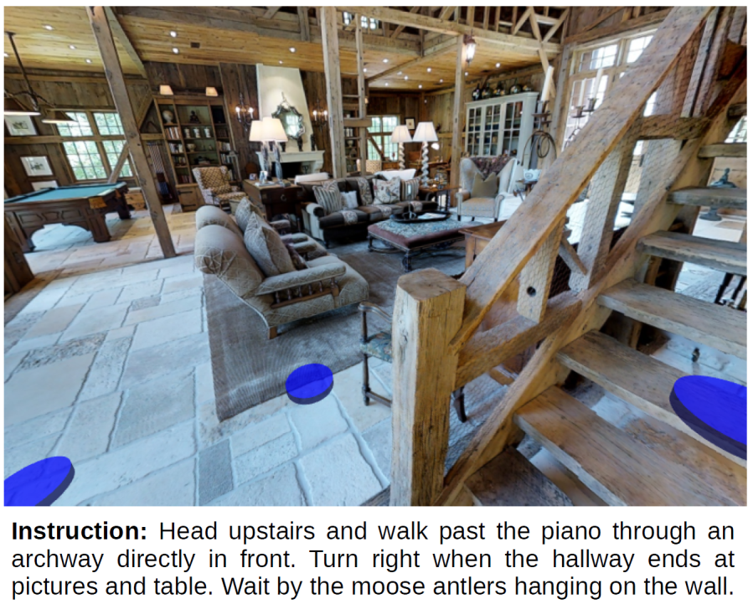

Slide 8
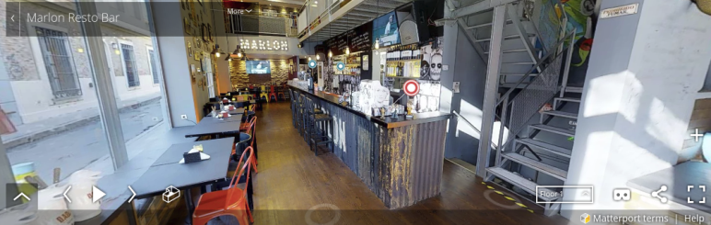
Matterport images
700k+ real environments full of real objects
Not just a small set of 3D models rendered in different spots
There’s no actions, some bias, and they’re spatially sparse
https://matterport.com/gallery/

Slide 9
Matterport3D Simulator
Simulator for embodied visual agents, based on Matterport3D dataset (Chang et al. 2017)
Contains 10,800 panoramic images / 90 buildings
High visual diversity

Slide 10
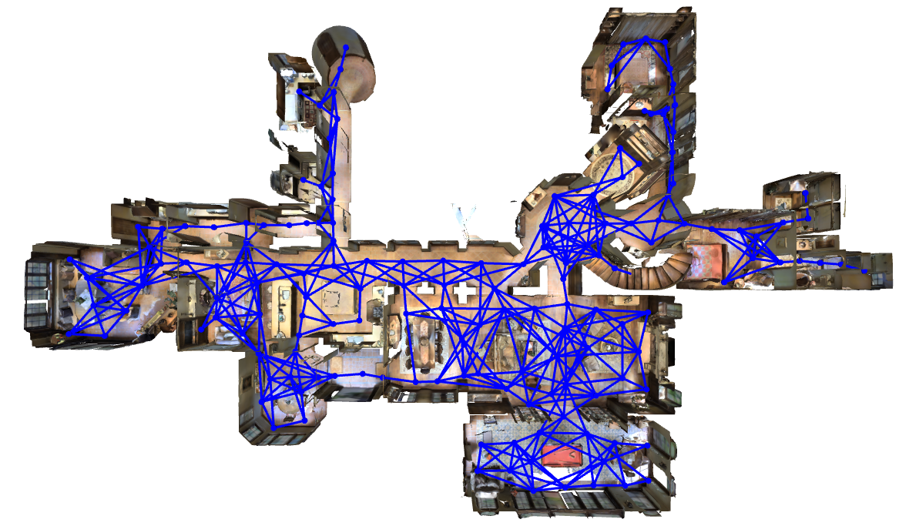
Feasible trajectories determined by navigation graph

Slide 11
Room-to-Room (R2R) Navigation dataset
Vision-and-Language Navigation Task: Given a natural language navigation instruction, navigate through the environment to find the goal location
Dataset Statistics: 21,567 navigation instructions collected using AMT. More data on the way!
Clear Evaluation Protocol:
Single test run
Agent must choose to stop
Success measured if stopped within 3m of the goal location
Project url: https://bringmeaspoon.org/

Slide 12
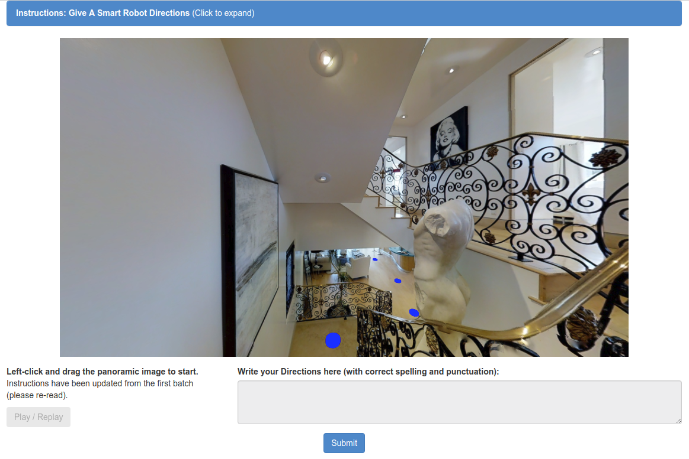

Slide 13
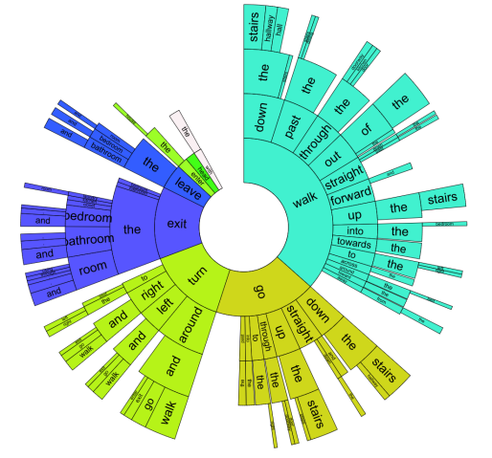
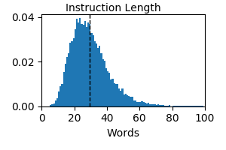
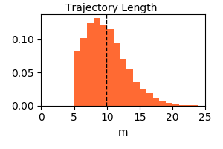
Room-to-Room (R2R) Navigation dataset
Dataset Statistics: Average instruction length of 29 words, average trajectory length is 10m.

Slide 14
Simulation: The good, the bad, and the opportunity
The good
It’s almost open set
Objects
Commands
Actions
They’re real images
Every object is an individual
The objective function is concrete
The bad
It’s not really open set
It’s only navigation (no other actions)
But how can we represent an open set of actions?
There’s bias in the image set
The opportunity
Better metrics
We’re tried language and that didn’t work
Better tasks
How can we specify and evaluate realistic tasks without prescribing them
Better actions
Prescribing the actions can lead to gross oversimplification
‘Turn on the coffee machine’ is complex

Slide 15
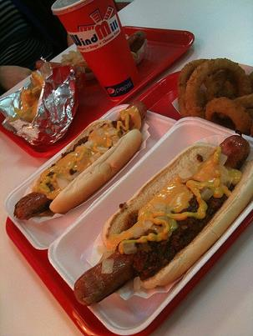
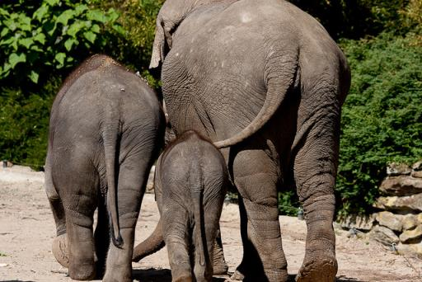
State-of-the-art in image captioning
Two hot dogs on a tray with a drink.
Two elephants and a baby elephant walking together.
⁵Anderson et al. CVPR 2018

Slide 16
Same model on non-COCO images
A zebra is laying down in the grass.
So perhaps synthetic images don’t teach us enough about the real world
But real images don’t either
The problem is that the methods don’t generalise
We’re asking the wrong questions
Domain adaptation isn’t the solution, it’s a symptom of the problem

Slide 17
Where are we going again?
Many critical problems in robotics require interacting with humans
Natural language interfaces are flexible and powerful
And this is critical. How can we know what people will say in advance?
Dialogue is critical (your robot has to talk back)
I think your robot needs to learn new capability through dialogue
Robustness, flexibility, and effectiveness require reasoning
At least about human intent and how to achieve it
Particularly when things go wrong
And it needs to happen continuously
So set-and-forget ML won’t work
We already know how to do a bunch of things
There are great methods for Planning for a fully specified problem already
In navigation there are dynamic things you need to know
Object locations, office locations, whether there’s paper in the photocopier…
Deep learning (fundamentally) can’t do these things
The answer is to incorporate dynamic information

Slide 18
Separating the information from the QA
Visual Question Answering as a Meta Learning Task,
Damien Teney, Anton van den Hengel, ECCV’18

Slide 19
Learning to reason
Visual Question Answering as a Meta Learning Task,
Damien Teney, Anton van den Hengel, ECCV’18

Slide 20
It works!

Slide 21
Open set VQA?
Separates the question answering from the information used
The method doesn’t attempt to learn all of the answers
C.f. standard VQA trying to learn all of Computer Vision
It learns how to answer questions using the information currently available
It learns how to reason
Can generate answers not seen during training
Doesn’t need retraining for each new object
No fixed ontology!
It’s open set at training time anyway

Slide 22
Some ideas
Datasets have driven incredible progress in Vision
But at a cost
Simple tasks, that are easy to evaluate
Incremental progress is easy (engineering over big ideas)
It’s time to move on to more interesting questions, with or without the datasets
The primary dataset criterion is that it should enable evaluation of an interesting problem
Synthetic isn’t a dirty word, but it’s not a solution alone
Dataset doesn’t have to mean a discriminative task
Generative evaluation is more difficult
How can we evaluate “Find my old Milli Vanilli records and burn them”
I don’t actually own any Milli Vanilli records
Synthetic simulation can help overcome this, but it’s not enough
Datasets aren’t real anymore
There are so many that you can just pick the one your method works on
The real world is constantly changing

